Slide 1
Lecture No. 6 Storage Devices - Batteries
At the end of this lecture, students will be able to:
Explain the working principle of Primary- Zn-MnO₂ and Secondary – Lead Acid battery
Describe the construction of Primary- Zn-MnO₂ and Secondary – Lead Acid battery
Discuss the applications of Primary- Zn-MnO₂ and Secondary – Lead Acid battery

Slide 2
History of Primary Batteries
By 1876, the wet Leclanché cell was made with a compressed block of manganese dioxide
In 1886 Dr. Carl Gassner patented a "dry" version by using a zinc cup as the anode and making the electrolyte with a paste of plaster of Paris (and later, wheat flour) to gel and immobilize the electrolyte
In 1898 Conrad Hubert used consumer batteries manufactured by W. H. Lawrence to power what was the first flashlight, and subsequently the two formed the Ever Ready battery company

Slide 3
History of Primary Batteries
In 1900 Gassner demonstrated dry cells for portable lighting at the World's Fair in Paris. Continual improvements were made to the stability and capacity of zinc–carbon cells throughout the 20th Century
By the end of the century the capacity of a zinc–carbon cell had increased fourfold over the 1910 equivalent
Improvements include the use of purer grades of manganese dioxide, better sealing, and purer zinc for the negative electrode

Slide 4
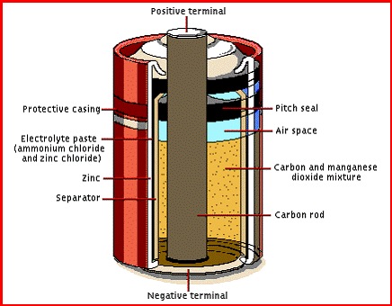
Construction and Working of Dry Cell Zn-MnO₂ Battery
This battery is a primary battery,
because the reactions are irreversible
and it can not be recharged
Graphite rod (Cathode)
Paste of MnO₂ and graphite
Paste of ZnCl₂ + NH₄Cl
Zinc container (Anode)
Plastic coating
How dry cell works?
Cell potential: 1.5 V

Slide 5
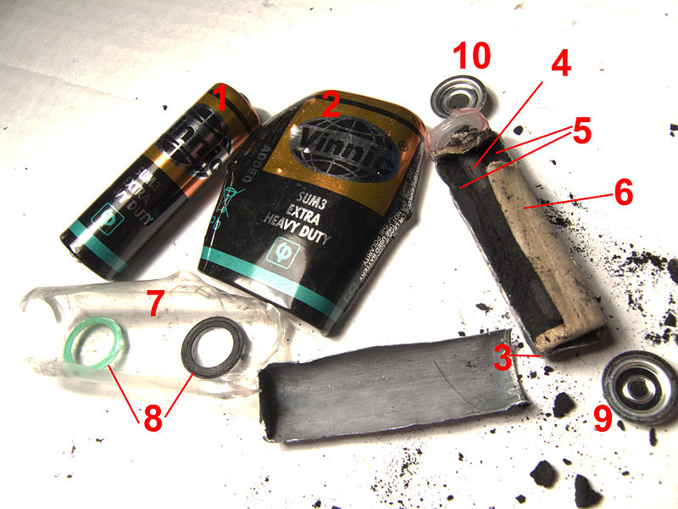
Disassembled Zn-MnO₂Cell:
Construction and Working of Dry Cell Zn-MnO₂ Battery
1:entire cell, 2:steel casing, 3:zinc negative electrode, 4:carbon rod, 5:positive electrode (Manganese dioxide mixed with carbon powder and electrolyte), 6:paper separator, 7:polyethylene leak proof isolation, 8:sealing rings, 9-negative terminal, 10-positive terminal (originally connected to carbon rod)

Slide 6
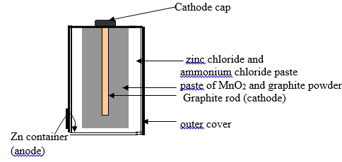
Working of Dry Cell Zn-MnO₂ Battery
Construction:
Consists of a cylindrical zinc container acting as anode
Graphite rod placed at the center of the container acting as cathode
Zinc container is in contact with a paste of NH₄Cl and ZnCl₂ acing as the electrolyte.
Graphite rod is surrounded by a paste of MnO₂ and graphite.

Slide 7
Working of Dry Cell Zn-MnO₂ Battery
Side reactions and depletion of the active chemicals increases the internal resistance of the battery, and this causes the e.m.f. to drop

Slide 8
Working of Dry Cell Zn-MnO₂ Battery
Battery has an e.m.f. of about 1.5 V. (Practically this battery provides an e.m.f of ~ 1.2V)
Although carbon is an important element of the battery's construction
Takes no part in the electrochemical reaction
Instead only serves to collect current and reduce the resistance of the manganese dioxide mix

Slide 9
Dry Cell Zn-MnO₂ Battery
Characteristics:
Cells have a low energy density; the voltage falls during use due to a drop in electrolyte concentration around the cathode and the time required for the Mn₂O₃ to diffuse away from the cathode
Dry cells have a short shelf life as the zinc is attacked by ammonium chloride
Zinc container becomes thinner as the cell is used, because zinc metal is oxidized to zinc ions
When the zinc case thins enough, zinc chloride begins to leak out of the battery
Storage at higher temperatures reduces the expected service life

Slide 10
Dry Cell Zn-MnO₂ Battery
Environmental Impact:
Conveniently manufactured, and disposed, a single dry cell has low environmental impact on disposal, compared with some other battery types
Manganese (III) is readily oxidized and so becomes immobilized; minute amounts of zinc, carbon and ammonium salts are also harmless
Applications:
Used in low drain or intermittent devices such as remote controls, flashlights, clocks, torches, toys, transistors or radios
How Zn-MnO₂ works?

Slide 11
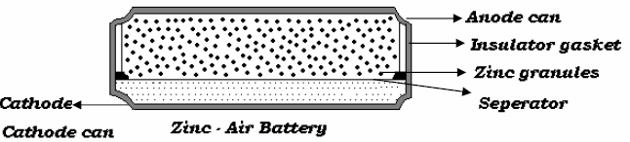
Zn-Air Battery
Construction of Zinc air battery
Anode containing granules of zinc mixed with 20%NaOH electrolyte
Cathode can contains a porous carbon plate which provides site for the reduction reaction and do not involves in the reaction
Carbon is catalytically activated to absorb oxygen gas
Anode and Cathode compartments are separated by a separator and both are encased in plastic or ebonite insulator

Slide 12
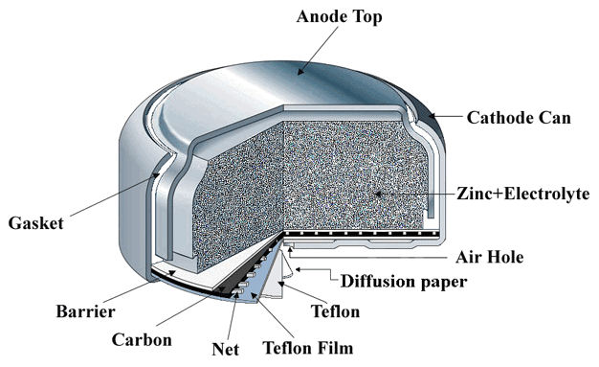
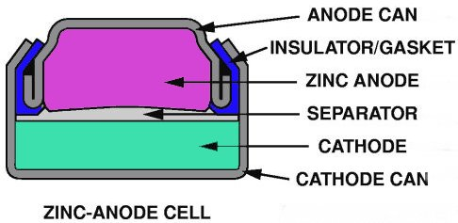
Construction and Working of Zn-Air Battery
Specific energy | 470 (practical),1370 (theoretical) Wh/kg (1.692, 4.932 MJ/kg)
Energy density | 1480-9780 Wh/L (5.328–35.21 MJ/L)
Specific power | 100 W/kg
Nominal cell voltage | 1.65

Slide 13
Construction and Working of Zn-Air Battery
Teflon layer allows oxygen, to diffuse into and out of the cell, and also provides resistance to leakage
Alkaline electrolyte employed is an aqueous solution of potassium hydroxide with a small amount of zinc oxide to prevent self-discharge of the anode
E_{cell} = 1.65 V

Slide 14

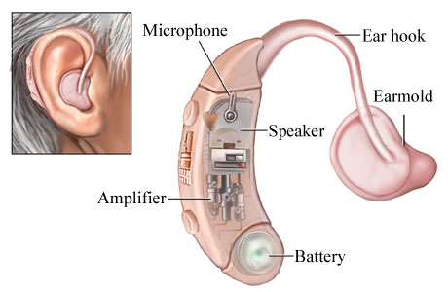
Zn-Air Battery
Advantages
It has high energy density and long shelf life
Cost of the battery is low and it has no ecological problem
Applications
Small button cells in hearing aids; larger batteries in film cameras, very large batteries in electric vehicle propulsion

Slide 15

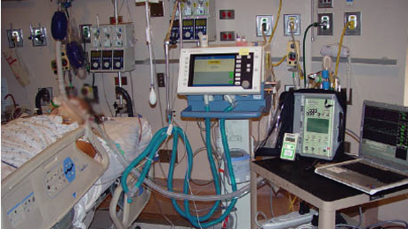

Zn-Air Battery
Used in pagers and wireless headsets
Used to power a number of medical devices, such as patient monitors and recorders, nerve and muscle stimulators, and drug infusion pumps

Slide 16
Secondary Batteries
Secondary Batteries are those batteries where the reactions are reversible in nature Ex: Lead Acid, Ni-Cd, Ni-MH battery, etc.
Secondary batteries need to have the following criteria:
Mechanical and chemical stability of the used electrode and electrolyte materials
Huge energy storage capability
Wide temperature range of operation (-40 to 85 °C)
Enhanced safety especially inflammability
Negligible self-discharge
Flat shape of the discharge curve
Short charge time
Long cycle life time with almost unchanged capacity and Low costs

Slide 17
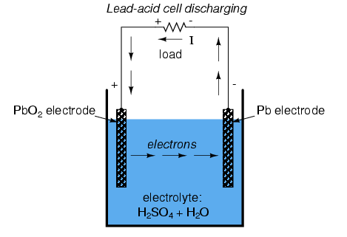
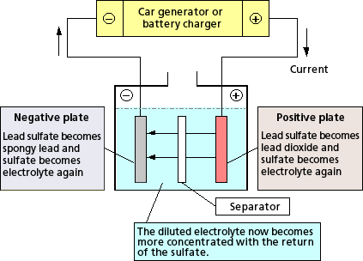
Construction and Working of Lead Acid Battery
Discharging Charging

Slide 18
Construction and Working of Lead Acid Battery
Construction:
Anode and Cathode are made up of lead grids
Anode grid is packed with spongy lead
Cathode grid is packed with PbO₂
Electrode pairs are separated by a separator made up of polyethylene
Electrodes are dipped in an electrolyte of about 37 % H₂SO₄ with specific gravity 1.25
In the discharged state both electrodes turn into lead sulfate and the electrolyte is consumed during the process
Reverse reactions occur during recharge

Slide 19
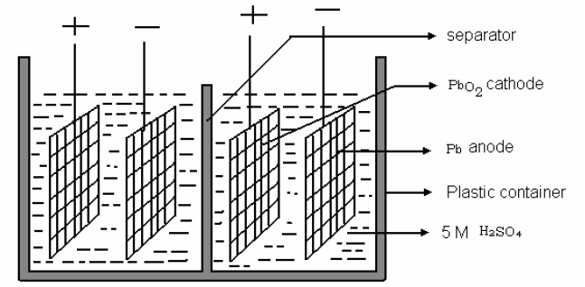
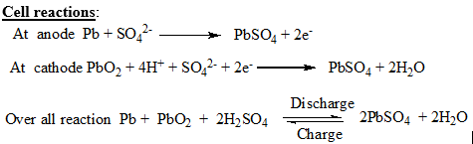
Working of Lead Acid Battery

Slide 20

Working of Lead Acid Battery
During discharging reactions the specific gravity of sulphuric acid comes down
When it reaches 1.2 the battery needs to be recharged
Voltage output is 2V
During recharging the above cell reaction is reversed and sulphuric acid is regenerated

Slide 21
Characteristics of Lead Acid Battery
Characteristics
Specific energy 33–42 Wh/kg
Energy density 60–110 Wh/L
Specific power 180 W/kg
Charge/discharge efficiency 50–95%
Self-discharge rate 3–20%/month
Cycle durability 500–800 cycles
Nominal cell voltage 2.0 V
Charge temperature interval min. −35 °C, max. 45 °C

Slide 22
Applications
Lead acid battery is preferred for hospital equipment, telephone exchanges, emergency lighting and UPS systems
Also used in automobiles to start the engine
Commonly used in large backup power supplies for telephone and computer centers, grid energy storage, and off-grid household electric power systems

Slide 23
Environmental Concerns
Lead compounds are extremely toxic
Long-term exposure to even tiny amounts of these compounds can cause brain and kidney damage, hearing impairment, and learning problems in children
However effective recycling of lead can prevent pollution due to lead

Slide 24
Summary
Construction and working of Primary Zn-MnO₂ and Zinc air battery
Zn + 2MnO₂ + 2NH₄⁺ → Mn₂O₃ +Zn²⁺ + 2NH₃ + H₂O
Zn + ½ O₂ → ZnO
Construction and working of Secondary Lead-Acid battery
Charging

Discharging

